Slide 1
Data Base System Week 1st Topics
Data
Information
Difference between Data & Information
System
Manual System
File Processing System
Database System

Slide 2
Data Base System Week 1st Topics
Data
A collection raw facts and figures
A resource is anything that is valuable for an organization
Examples
Student Admission form
During census, all citizen data
organization survey about product
Types of Data
Numeric Data
Alphabetic Data
Alphanumeric Data
Image Data
Audio & Video Data

Slide 3
Data Base System Week 1st Topics
Information
Processed data is called information
it is more meaningful than data and used for decision making
Examples
Student total marks from subject marks
list of students from abbottabad from students admission form
How many people are satisfied from a product?
Difference between Data & Information
Data
Processed
Information
Data | Information
Used as input in the computer | output of the computer
Not meaningful, huge in volume | Meaningful, short in volume
If loss difficult to reproduce | It can be reproduced easily from stored data
Used rarely | Used frequently
Data is independent | Information depends on data

Slide 4
Data Base System Week 1st Topics
System
Natural Systems
Made by God e.g. solar system
Artificial Systems
Made by human e.g. car system
Examples
Manual System
A system in which people collect data, classify, arrange and perform manual calculation to produce output required for the people
Examples
Admission in school. Colleges and universities
Shop keeper etc
Advantages
Simple and easy to use if data is limited
Inexpensive
Disadvantages
If data is huge the manual system become complex e.g. NADRA
Becomes Expensive (more employees, salaries, space etc)

Slide 5
Data Base System Week 1st Topics
Manual System (continued ..)
Need communication lines e.g. telephone, internet, post etc
Paper work burden
Error prone methods
Time consuming in searching, processing and calculation
Security problems
No backup and recovery
No data sharing
etc
File-Based System
Collection of application programs that perform services for the end users (e.g. reports).
Each program defines and manages its own data
Also called application / traditional file system i.e. an early attempt and became tradition to computerized the manual file system
Application programs like MS word, MS excel, program in C / COBOL

Slide 6
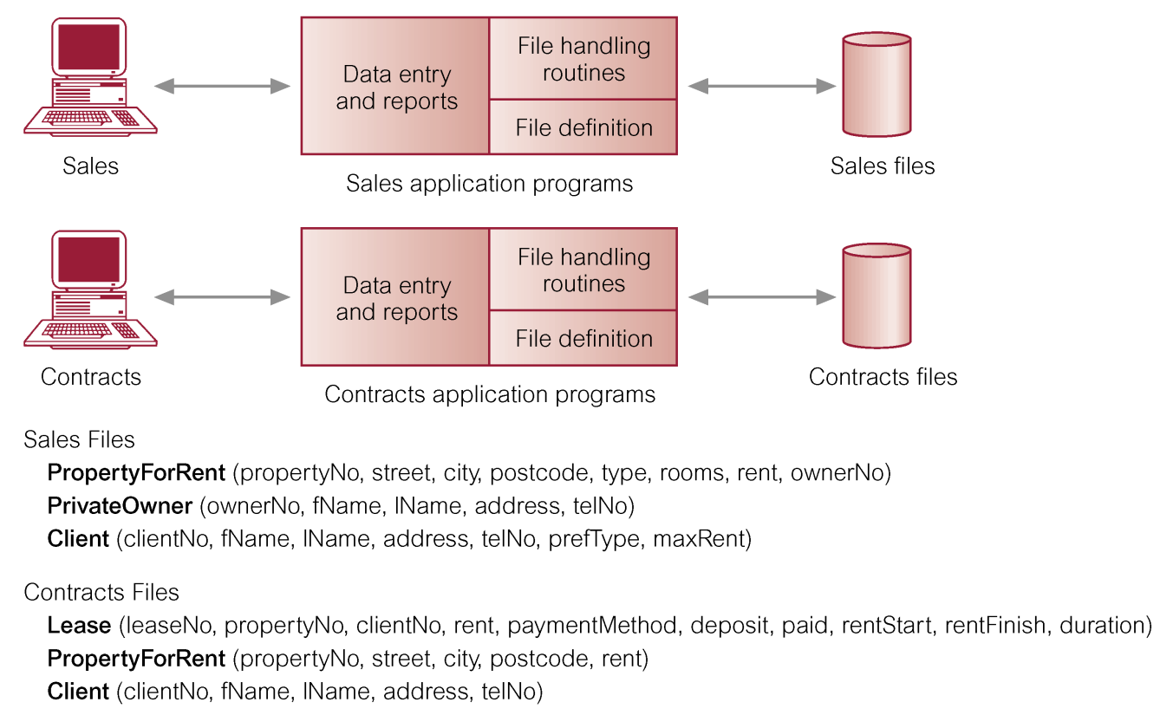
Week 1st Topics
File-Based System (continued ..)
Each department in an organization has its own set of files
Files are designed especially for their own applications
The records in one file are not related to the records in another file
Examples

Slide 7
Data Base System Week 1st Topics
File-Based System (continued ..)
Limitations of File-Based Approach
Data Redundancy & Inconsistency
Data may be duplicated in several files
Example
Suppose two files: student and library
Student (RNO, Name,address,contactno)
Library (Rno, Name along with rented book info)
Same data is held by different programs.
Wasted space and potentially different values and/or different formats for the same item.
Inconsistency means two files may contain different data of the same student
Example
If the address of student changes then change is required in every file containing the address
Data Isolation
Each program maintains its own set of data.
Users of one program may be unaware of potentially useful data held by other programs.
Difficult to generate a report or list from multiple files e.g. fee payment message from student and fee file

Slide 8
Data Base System Week 1st Topics
File-Based System (continued ..)
Limitations of File-Based Approach
Integrity Problems
Integrity means accuracy and reliability of data
E.g. student subject marks will be numeric and not more than 100
Program Data Dependency
Definition of data was embedded in application programs, rather than being stored separately and independently.
No control over access and manipulation of data beyond that imposed by application programs.
e.g. if the address length is changed it requires change in the program
Atomicity Problems
Means that either one transaction (steps to complete a process) should take place as a whole or it should not take place at all
Example
Suppose transfer of money from account A to B
1) Deduct money from account A 2) Add money to account B
File Processing System does not provide the facility to ensure atomicity of data

Slide 9
Data Base System Week 1st Topics
File-Based System (continued ..)
Limitations of File-Based Approach
Security Problems
Not provide adequate security to data
Program Maintenance
The programs developed are difficult to maintain making difficult to develop new programs
Programs are written to satisfy particular function. Any new requirement needs a new program
Programs are written in different languages, and so cannot easily access each other’s files

Slide 10
Data Base System Week 1st Topics
Database
“A shared collection of logically related data (and a description of this data), designed to meet the information needs of an organization”
Shared collection: data is same but available to various functional units (departments)
Logically related: different users accessing the data over a link (network) to satisfy their needs i.e. DB is designed, built and populated with data for a specific purpose and has an intended group of users and some preconceived applications in which these users are interested.
A database can be of any size and varying complexity e.g. A school DB with a few hindered records while NADRA DB millions of citizen records
A DB may be generated and maintained manually e.g. Library card catalogue or it may be computerized created by a group of application programs written specifically for that task or by a DBMS.
Defining a DB:
Constructing the DB:
Manipulating the DB:

Slide 11
Data Base System Week 1st Topics
Database
Example
a University Database
Students, Courses, Section, Grade_Report and Prerequisite
1) To Define this : we must specify the structure of the records of each file by specifying the different types of data elements and its data types
2) To Construct the DB: we store data in each file
3) To manipulate the DB: involves querying and updating.
Examples of Database Applications
Purchases from the supermarket
Purchases using your credit card
Booking a holiday at the travel agents
Using the local library
Taking out insurance
Using the Internet
Studying at university

Slide 12
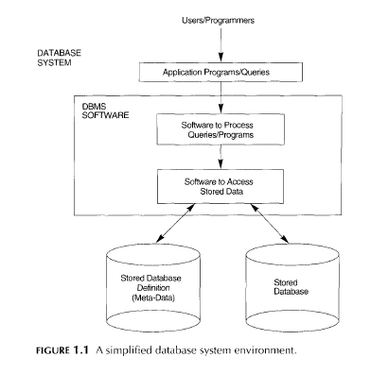
Data Base System Week 1st Topics
Database
Database System
A record keeping system i.e. computerized system
Overall purpose is to store data, to allow users to retrieve, update data on demands

Slide 13
Data Base System Week 1st Topics
Database System Components
1. Users / Programmers
1.1 Actors on the Scene
the people whose jobs involve the day-to-day use of a large database;
1.1.1 Database Administrator
The most technical user i.e. manage and administers the whole DB system
Design, creates and maintains the DB
Manages the users accessing the DB and maintains integrity issues
Installation of S/W (DBMS & related S/Ws)
Monitoring & troubleshooting of DB
Assigning permissions to users
Taking regular backups and recovery after DB crash or loss
Accountable for problems such as security breaches and poor system performance
In large organization, DBA is assisted by a staff that helps carry out these functions
Examples:

Slide 14
Data Base System Week 1st Topics
Database
1.1.1 Database Administrator (Conti..)
Examples: (Best Database Certifications for 2020)
IBM Certified Database Administrator – DB2
Microsoft SQL Server database certifications**
Oracle Certified Professional, MySQL Database Administrator
Oracle Database 12c Administrator
1.1.2 Database Designers
are responsible for identifying the data to be stored in the database and for choosing appropriate structures to represent and store this data
Database designers typically interact with each potential group of users and develop views of the database that meet the data and processing requirements of these groups
the DB design is based on the requirements of the users and final database design must be capable of supporting the requirements of all user groups
the designers are on the staff of the DBA and may be assigned other staff responsibilities after the database design is completed

Slide 15
Data Base System Week 1st Topics
Database System
1.1.3 User Group
The persons using DB system e.g. end users and computer operators
End Users
They interact with the system directly i.e. using specific access methods like insert, delete, update and generating reports etc
If number of users increases they are divided into sub groups according to their nature of work, authority and requirements
Naive or parametric end users
No technical Knowledge about the system
use database through application programs using simple user interfaces like menus and buttons etc
Example: Data Entry Operators (DEO) like Bank tellers. Reservation clerks for airlines etc
Sophisticated Users
familiar with the structure of DB and facilities of DBMS
Can use query language such as SQL
Can also write application programs
Example: engineers, scientist, business analyst and others.

Slide 16
Data Base System Week 1st Topics
Database
1.1.3 User Group (Contin…)
Casual End Users
occasionally access the database but they may need different information each time
They use a sophisticated database query language to specify their requests
Example: middle or high level managers or other occasional browsers
Stand alone users
maintain personal databases by using ready-made program packages (specific) that provide easy-to-use menu-based or graphics-based interfaces
Example: user of a tax package that stores a variety of personal financial data for tax purposes
1.1.4 System Analyst and Application Programmers (Software Engineers)
System analysts determine the requirements of end users, especially naive and parametric end users
develop specifications for canned transactions that meet these requirements.
Application programmers implement these specifications as programs; then they
test, debug, document, and maintain these canned transactions(standard types of queries and updates)
Examples are Web Developer, C# Developer, VB Developer, Oracle Developer etc

Slide 17
Data Base System Week 1st Topics
Range of Database Applications
Personal Computer Database
Specially designed for single users using PC or laptop
Used widely
Example
Representative of medical company i.e. record of customers
Problems
It is difficult to share quickly
Workgroup Database
Workgroup means a group of people working on the same project collectively i.e. less than 25 people connected through LAN, Database is on server while members access it
Problem
Security and integrity of data when the data is updated concurrently

Slide 18
Data Base System Week 1st Topics
Department Database
A functional unit in an organization is called Department (25 --- 100 people)
Databases are designed to specially supports department functions
Examples
Sales DB
Accounts DB etc
Enterprise Database
A database supports the functions of whole organization e.g. Data warehouse
Data warehouse contents are derived from many operational database like personal computer, workgroup and department DB
Examples
Coca-Cola/ Zong / telenor

